Slide 1
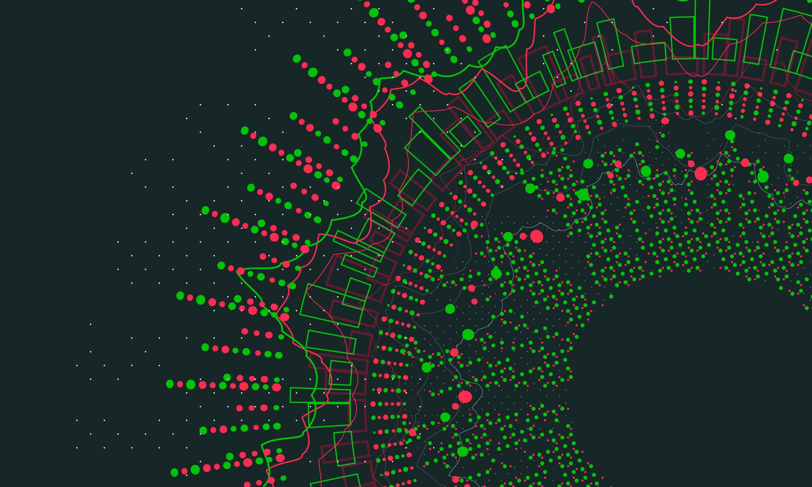
Why was there appeasement
Pre-WWII

Slide 2
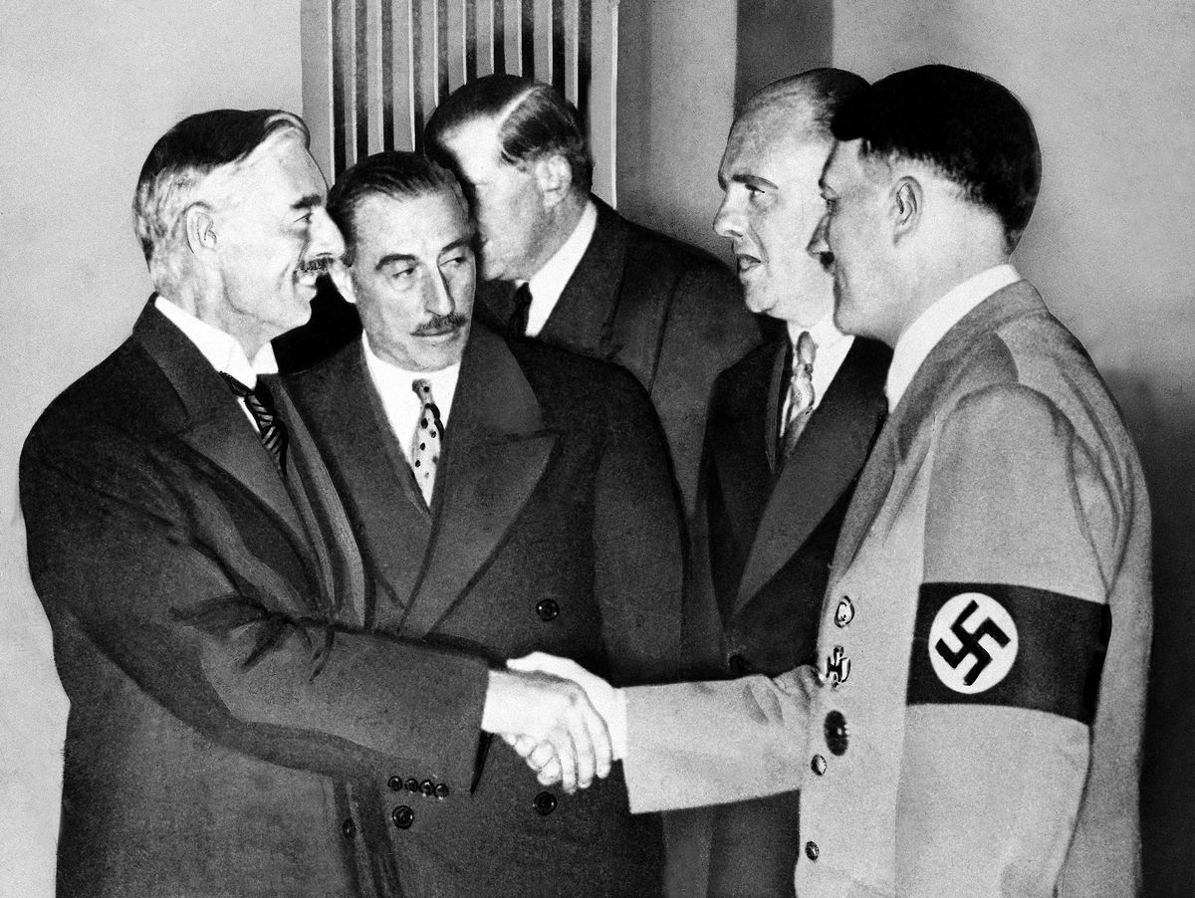
What's Appeasement?
Make Axis Happy || Inaction
Allowed Axis powers to strengthen
People Suffered

Slide 3
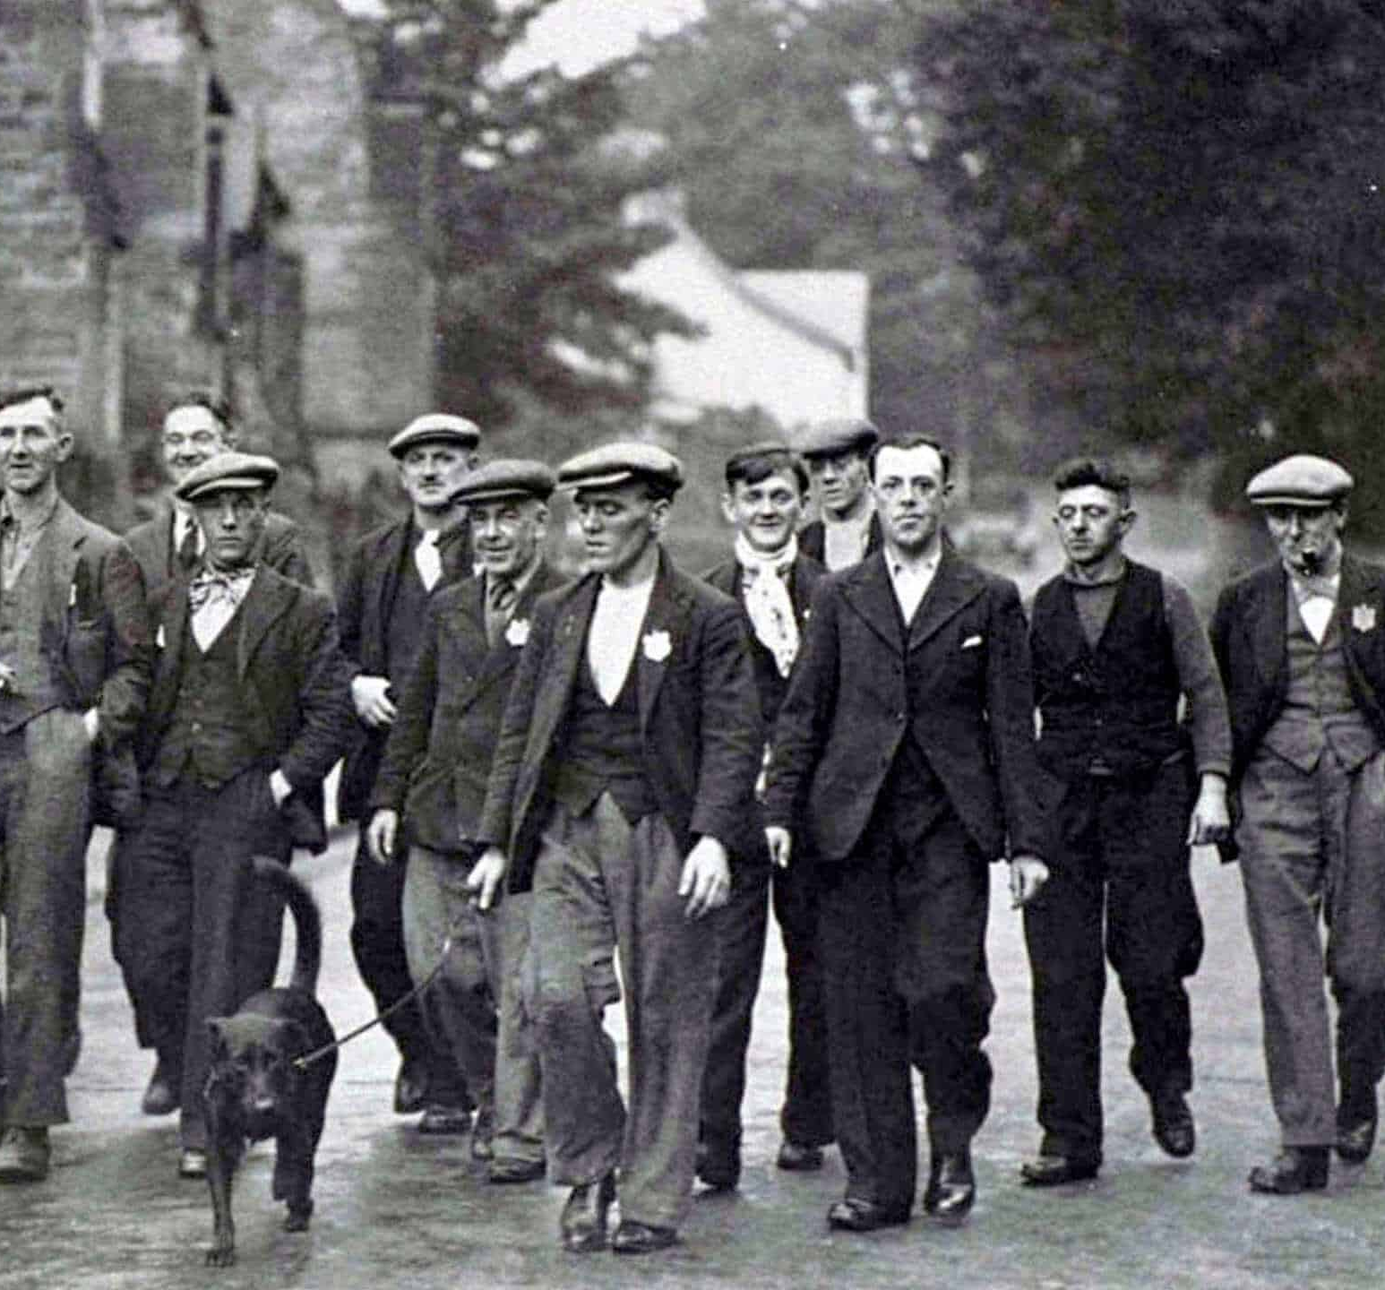
So why do it?
People against war
Economic relay
Falling behind Germany

Slide 4
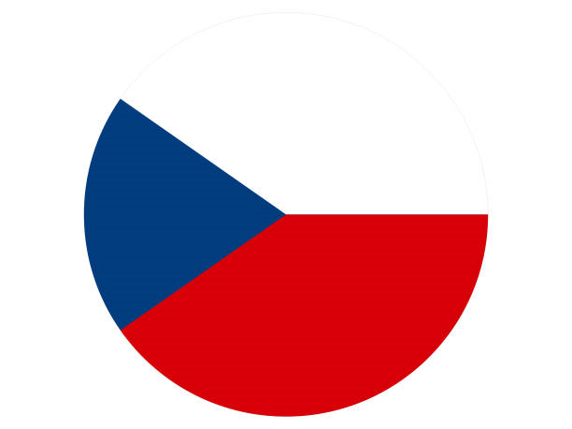
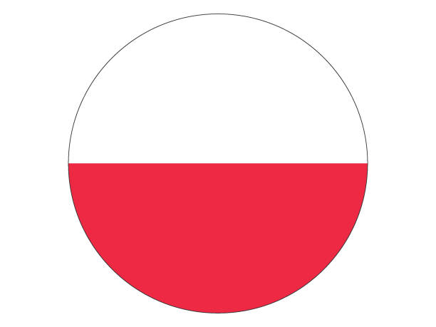


Appeasement Timeline
1938 March
1939
April
Anschluss
Invasion of Albania
1935
German
Conscription
1935
Octomber
1938 Octomber
1939 Seqtember
Invasion of Abyssinia
Munich Conference
Invasion of Poland
End of appeasement | WWII

Slide 5
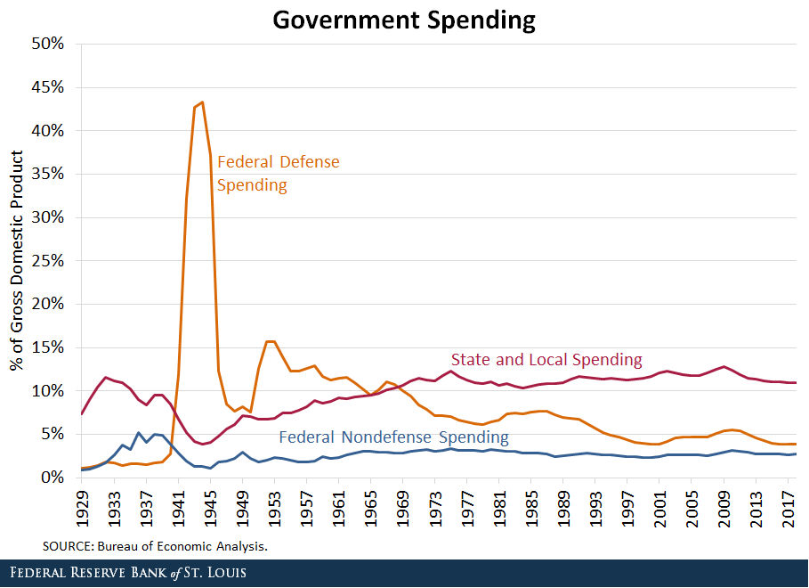
So, appeasement failed right?
Appeasement != Preventing War
Pluses = Power Up
Minuses = Power Up
Yea…

Slide 6
Thank YOU for your attention

